Slide 1


Tourist Management System
SQL Project
SQL Queries and Insights from the Tourist Database
- Kedar Swami

Slide 2
Introduction
Welcome to this presentation on the "Tourist Management System." This project explores the use of a structured SQL database to efficiently manage and analyze various aspects of tourism. The system is designed to encompass key elements such as tourist attractions, visitors, accommodations, transportation, events, and more. Through well-defined database relationships and insightful SQL queries, the project offers a comprehensive solution for understanding and optimizing tourist experiences.
In this presentation, we will delve into:
The database structure and its key components.
The relationships between tables, including primary and foreign keys.
Insights derived from queries, such as top-rated hotels, average event ratings, and visitor reviews.
By the end, we aim to showcase the system's potential to provide actionable insights for enhancing tourism management.

Slide 3
Database Structure
Name : Tourist
List of tables involved:
tourist_places
visitors
bookings
reviews
accommodation
transportation
Events

Slide 4
Table Relationships
Primary keys :-
Tourist_places (place_id)
Visitors (visitor_id)
Foreign keys :-
Bookings (visitor_id, Place_id)
Reviews (visitor_id, Place_id)
Events (Place_id)
Accommodation (Place_id)
Transportation (Place_id)

Slide 5
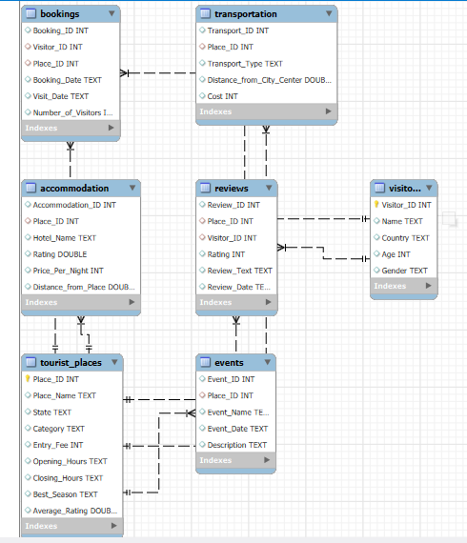
E–R Diagram :-

Slide 6
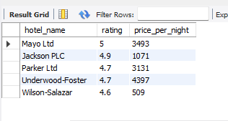
Top 5 Hotels with Highest Rating.
SELECT hotel_name, rating, price_per_night
FROM Accommodation
WHERE place_id = 1 ORDER BY rating DESC
LIMIT 5;

Slide 7
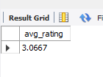
Average rating for a Specific Event.
SELECT AVG(rating) AS avg_rating
FROM Reviews
WHERE place_id = 1;

Slide 8
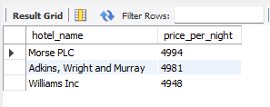
Top 3 Most Expensive Accommodations
SELECT hotel_name, price_per_night
FROM Accommodation
ORDER BY price_per_night DESC
LIMIT 3;

Slide 9
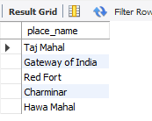
Places with Entry Fee Greater Than 100
SELECT place_name
FROM Tourist_places
WHERE entry_fee >= 100;

Slide 10
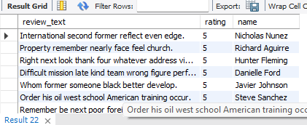
Reviews for a Place, Ordered by Rating
SELECT R.review_text, R.rating, V.name
FROM Reviews R
JOIN Visitors V ON R.visitor_id = V.visitor_id
WHERE R.place_id = 1 ORDER BY R.rating DESC;

Slide 11
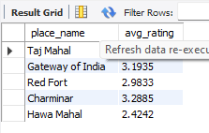
Places with Average Ratings
SELECT place_name, AVG(rating) AS avg_rating
FROM Tourist_places
JOIN Reviews R ON Tourist_places.place_id = R.place_id
GROUP BY Tourist_places.place_id;

Slide 12


Conclusion
Summary of the database structure and relationships.
Key insights from the queries: Most popular accommodations, events, visitors' ratings, and seasonal trends.
Suggestions for further improvements or extensions to the database.

Slide 13
Thank You…

